Slide 1
Category review: Chips
June 2020
Retail Analytics
Brand note: If client logo is not required, use alternate title page layout right click slide thumbnail > Layout > Title

Slide 2
Notes:
To view Privacy video explaining how important data privacy is to Quantium, please click here: https://www.youtube.com/watch?v=Zq1QDAkoRzU
or here Q:\Company Reference\Brand & Design\Brand videos\Q Privacy.mp4
At Quantium, we believe that data is the behavioural footprint of humanity and that it has to be treated with the utmost care and responsibility.
Histories, attitudes, indeed lives are stored within it in ways that aren’t always apparent – and that’s what makes its potential so powerful.
To work with it responsibly, sensitively, we set ourselves the highest data privacy protection and governance standards.
We have spent 17 years perfecting privacy-by-design and secure-by-design principles. Central to this is not holding any personally identifiable information about people –
we neither receive it, and put the necessary protections in place to be unable to decipher it.
Every aspect of handling data is safeguarded: from its de-identification, to its encryption – data security is paramount and of the highest grade.
We pride ourselves on gaining the trust of iconic organisations around the world through years of securely working with their data,
and in turn the trust that builds with their stakeholders.

Slide 3
Executive summary
01
The Mainstream category of Young and Mid-age Singles/Couples have the highest spending of chips per purchase.
The Older Families(Budget) have the highest frequency of purchase followed by Young Singles/Couples (Mainstream) and at last Retirees (Mainstream) contributing to a total 25% sales revenue.
Chips Brand Kettle and Doritos is the most purchased brand in all stores.
Young and Mid-age Singles/Couples is the only segment having Doritos as the highest purchase brand while Smiths is for other segments.
Most frequent chip size purchased is 175 gr followed by 150 gr size for all segments.
Chips transactions increase a lot before Christmas which can be an advantage with the help of promotional offers.
Task 1
02
Task 2
Trial stores 77 and 88 have significant increase in total sales and number of customers during trial as compared to control store.
Trial store 86 had increase in number of customers but not as much in Sales.

Slide 4
01
Category

Slide 5
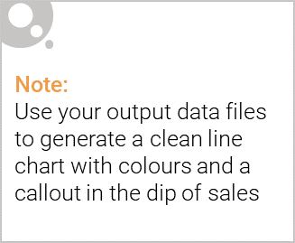
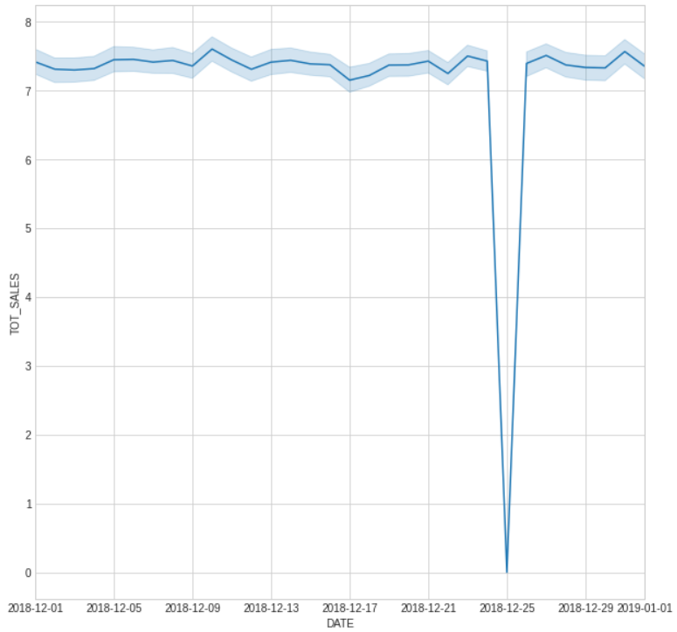
The day with no transaction is a Christmas day that is when the store is closed hence there is a dip in sales on 25th December as shops were non-operational.
Sales increase steadily as the Christmas day approaches and return again to early December sales level during New Year Eve.

Slide 6

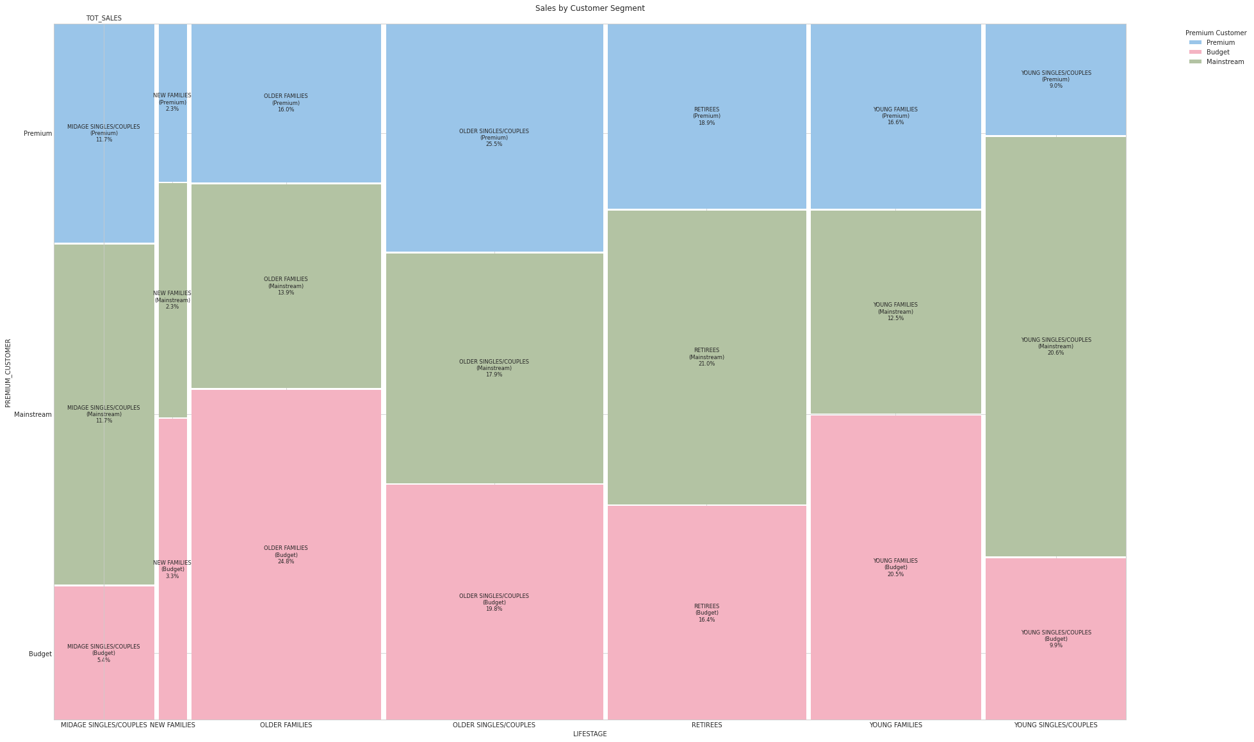
Sales mainly came from Budget - older families, Mainstream - young singles/couples, and Mainstream - retirees. In total contributing 25% of sales revenue.
Older and Young Family segment have the highest average purchase units per unique customer

Slide 7
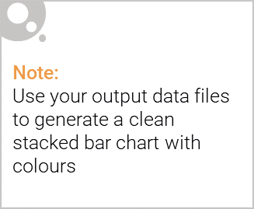
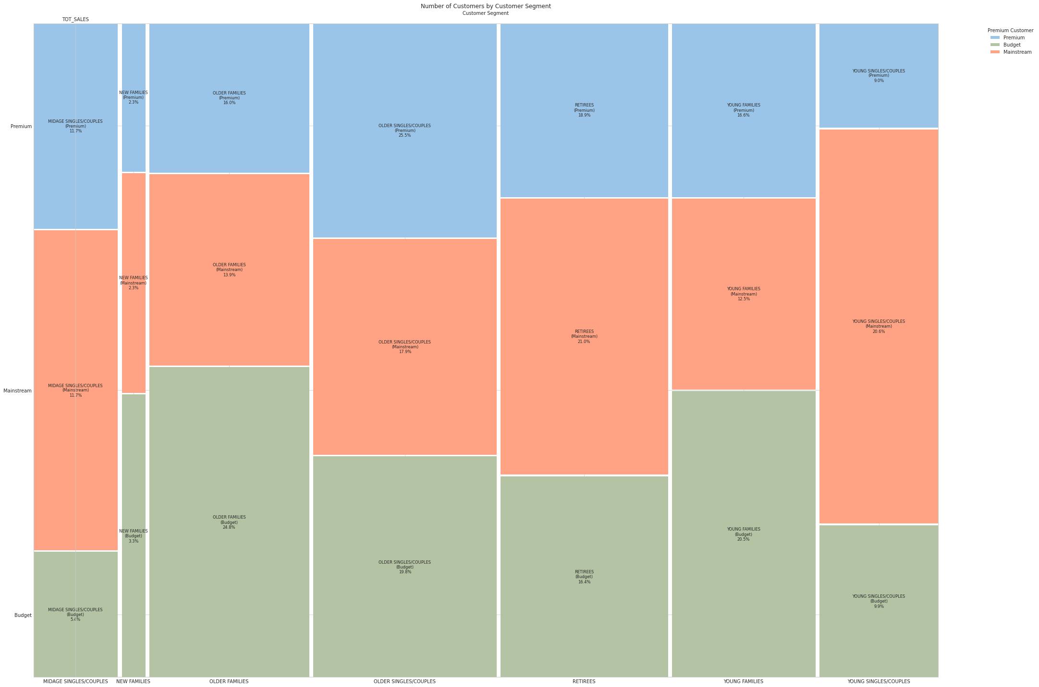
Editable (delete this)
There's Max number of Customer from Older Families Lifestage of budget category and lowest is New Families.
There are more Mainstream - young singles/couples and Mainstream - retirees who buy chips.
This contributes to there being more sales to these customer segments but this is not a major driver for the Budget- Older families segment.

Slide 8
02
Trial store performance

Slide 9
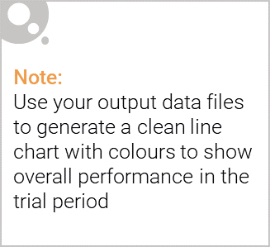
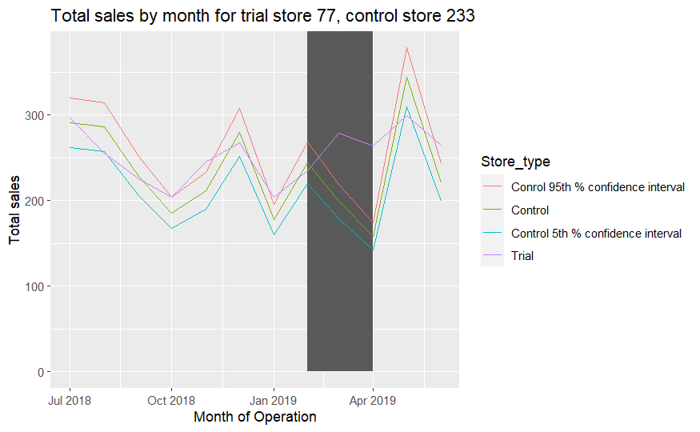
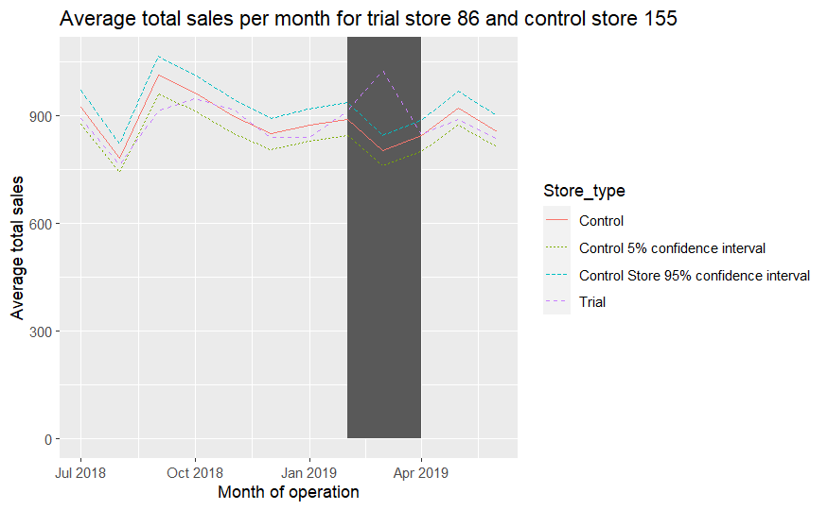
Trial Store 77 , 88 show a significant positive increase in Sale for the trial period which is Feb to April. On the other hand trial store 86 show an increase in number of customers but not enough sales.

Slide 10
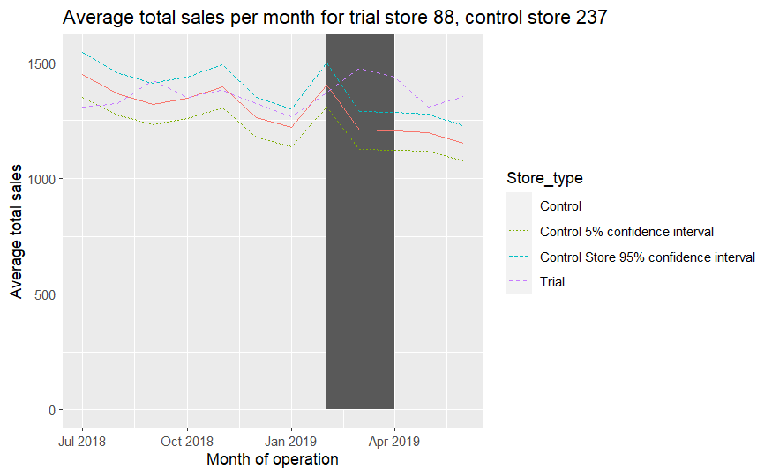

Slide 11
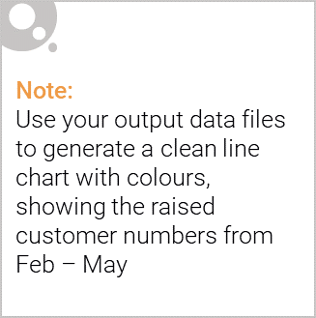
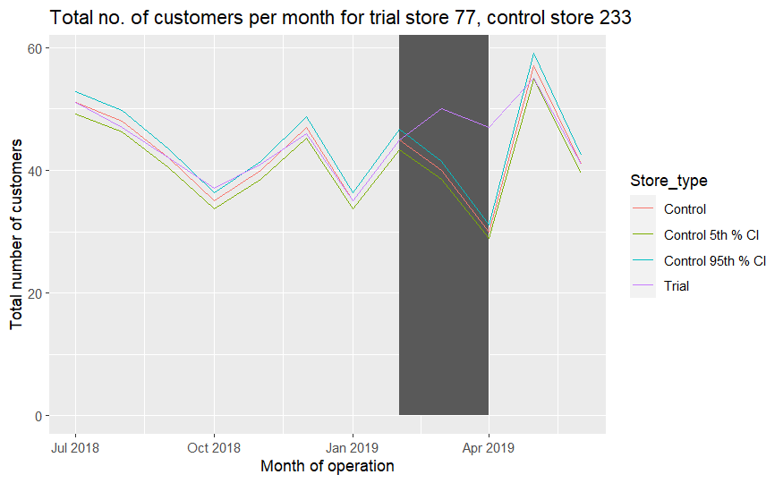
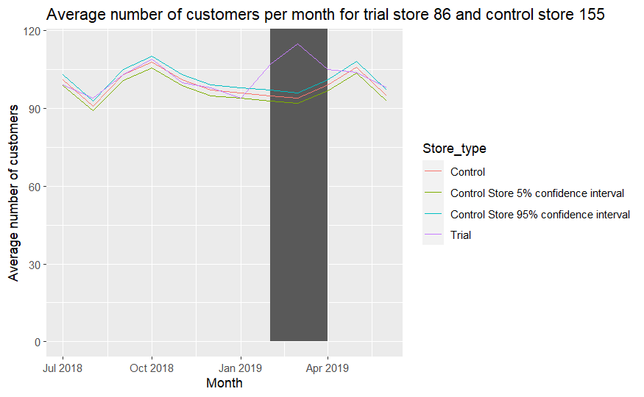
Trial store 77: Control store 233
Trial store 86: Control store 155
Trial store 88: Control store 237

Slide 12
